Slide 1

Moldova Dialogue for Peace, Understanding and Development
04 April 2025

Slide 2
Gagauzia Dialogue Process
Facilitate constructive and reflective thinking about Chisinau-Comrat relations
Build confidence, trust and relationships between key actors in Chisinau and Comrat
Identify issues and build consensus among key stakeholders on key issues
Foster joint problem analysis and joint problem solving
Development of common solutions
Gain support and buy-in of main international actors on jointly suggested solutions

Slide 3
Gagauzia Dialogue Process
Political Dialogue: Parliamentary Working Group on Gagauzia
Expertise and Analysis:
Analysis of institutional arrangements and relationships between the central authorities and the authorities from the Gagauz Autonomy
Course on “Administrative-Territorial Organization of the State and Multi-Level Governance” developed by the Institute of Public Administration
Policy Development Process: culture, tourism, education
Thematic Dialogue on Multilingual Education
Communication and visibility

Slide 4
Education and Dialogue
Knowledge Transfer for larger outreach
Course on “Administrative-Territorial Organization of the State and Multi-Level Governance” developed by the Institute of Public Administration
Policy Development Process: thematic Dialogue on Multilingual Education (MLE)
Concept for MLE approved by the government, Action Plan for implementation of MLE
Capacity building for larger group of stakeholders
Academia, government, civil society
Communication and visibility
Public lectures, Communication Campaign ‘30 years of Gagauz Autonomy’

Slide 5
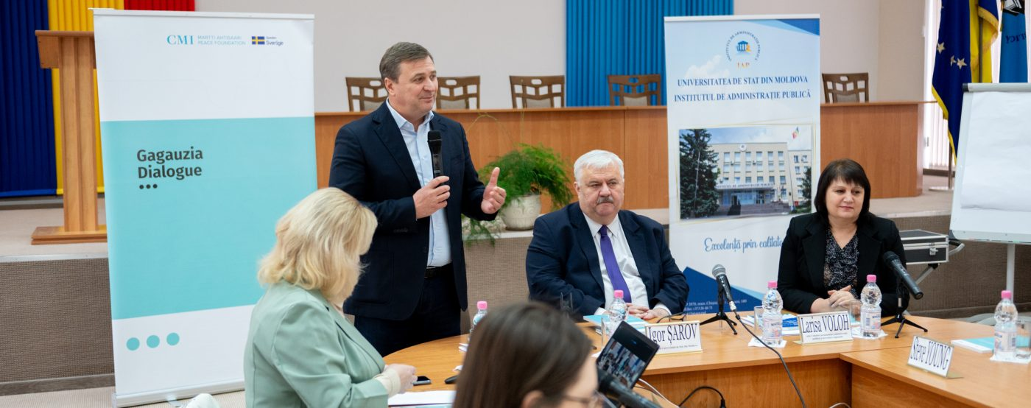

Slide 6
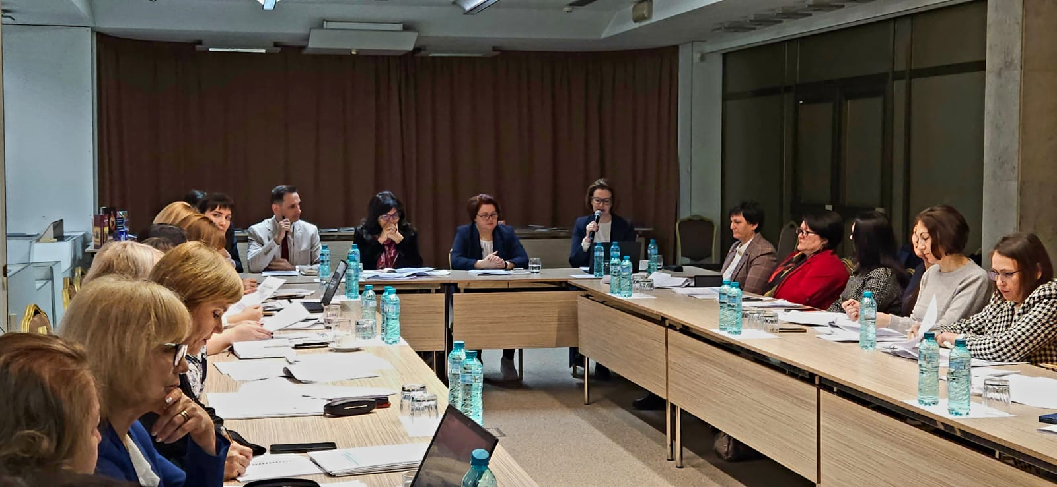

Slide 7
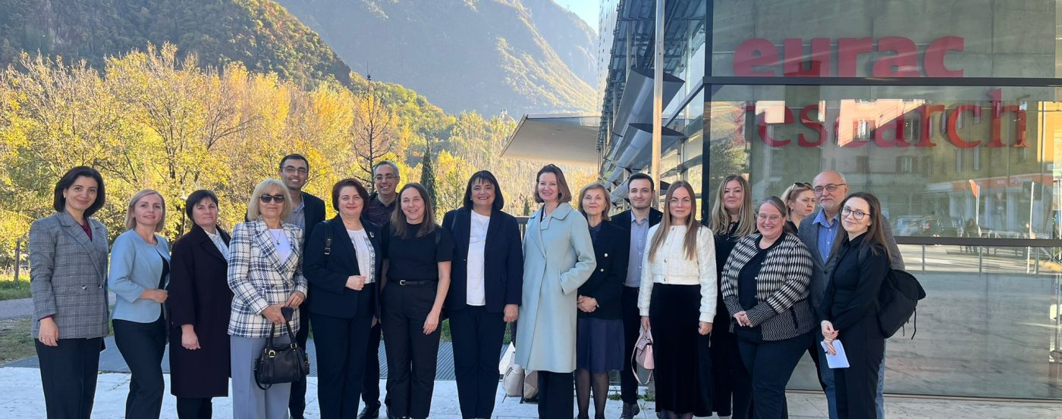

Slide 8
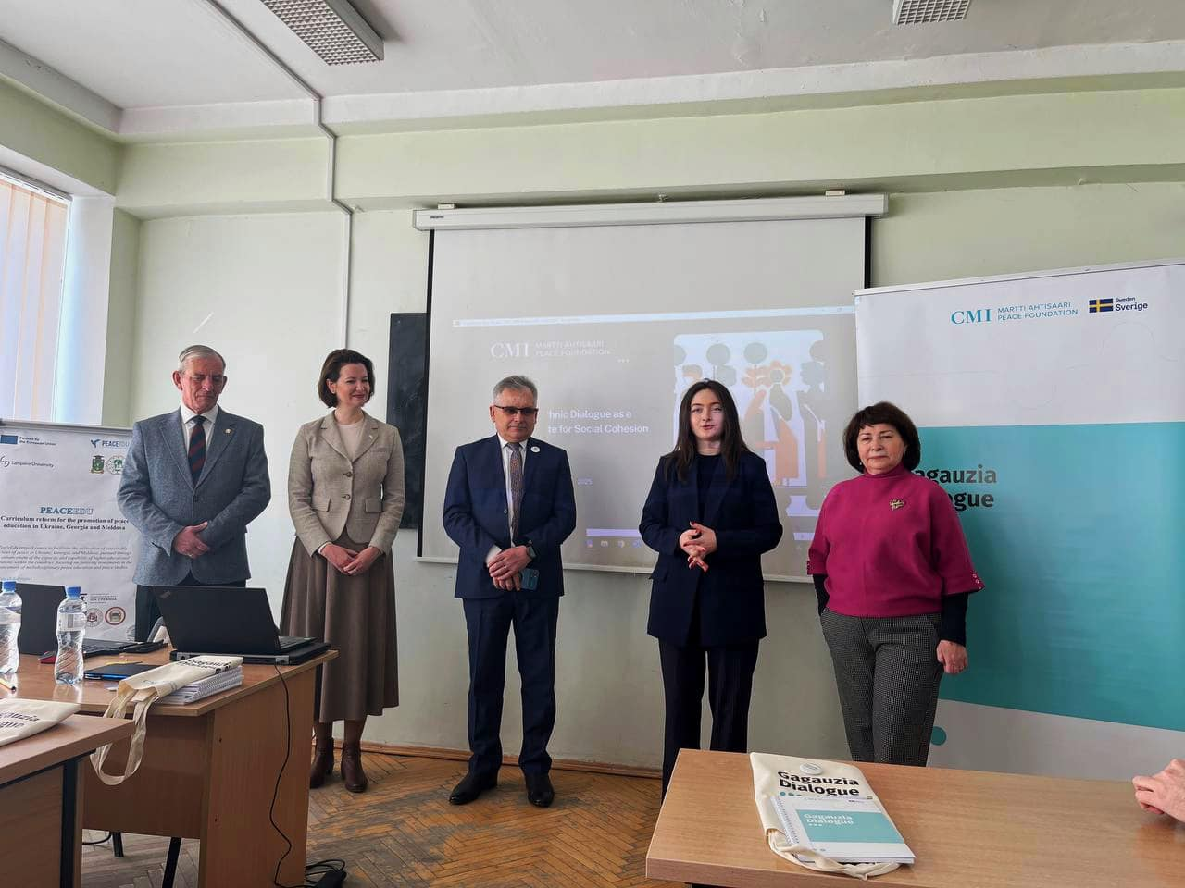

Slide 9
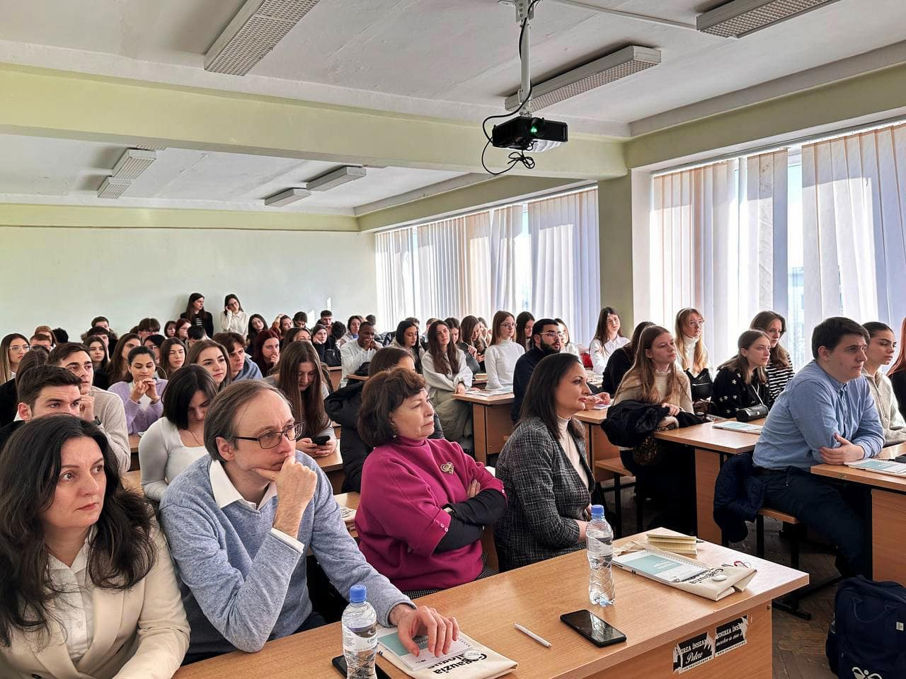

Slide 10
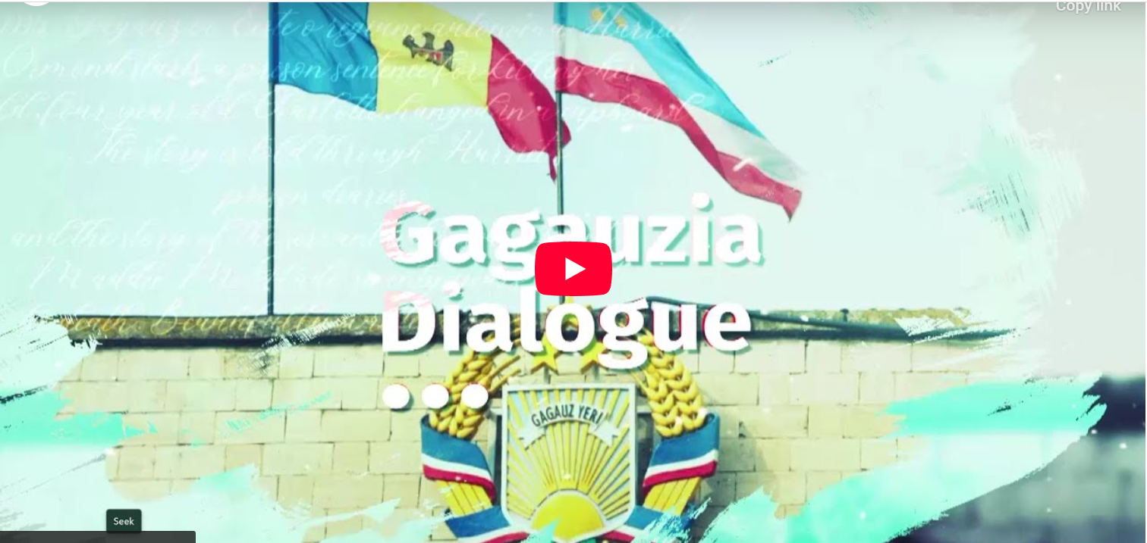

Slide 11
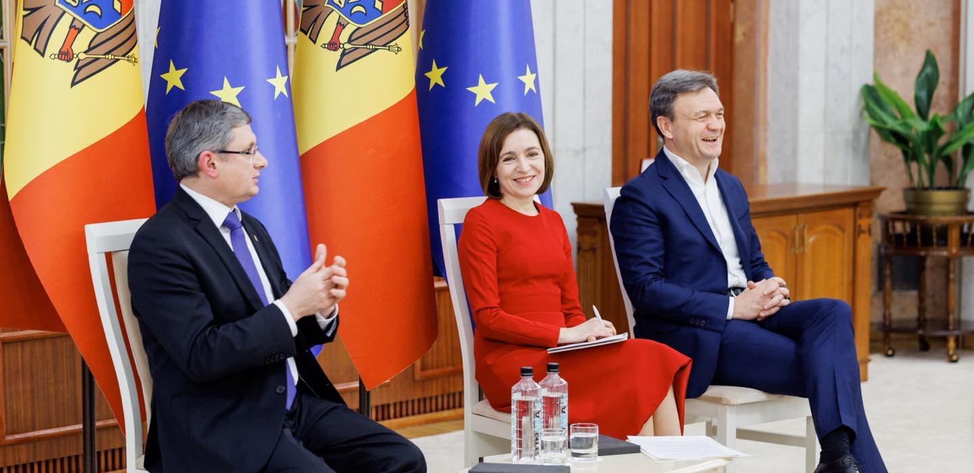

Slide 12
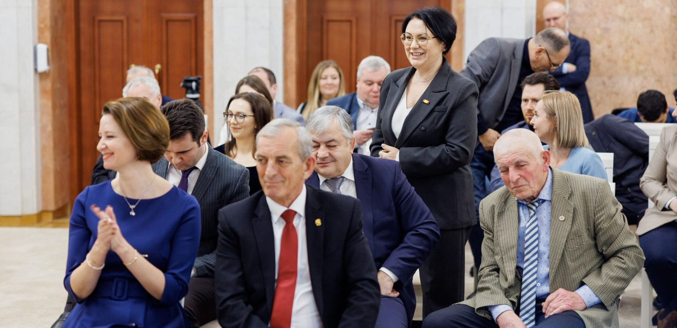

Slide 13



Thank you!

